Slide 1
Creating Stories Using Inklewriter
Organized By: CIET-NCERT
Wednesday, 10th April 2024
                Conducted By:
                Sonia Wadhwa
                Head, Salwan Junior School, Nariana
                Technology Integration Specialist,
                Salwan Education Trust, New Delhi

Slide 2
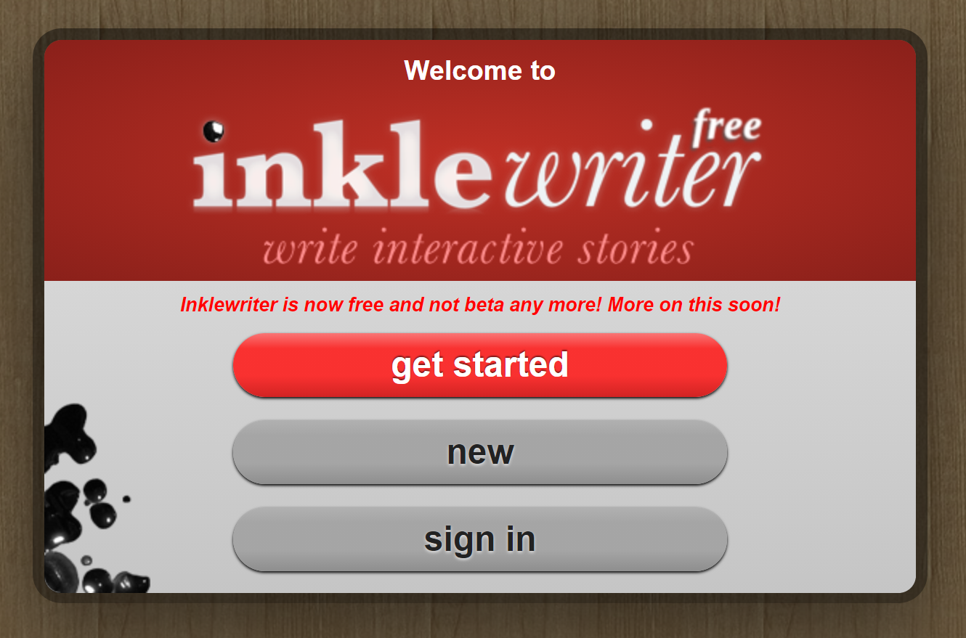
A tool used by programmers and the writers equally.

Slide 3
About the tool
Inklewriter एक निःशुल्क टूल है जिसे इंटरैक्टिव कहानियां बनाने और प्रकाशित करने के लिए डिज़ाइन किया गया है
यह उन लेखकों के लिए एक आदर्श सॉफ्टवेयर है जो इंटरैक्टिव कहानियां बनाना चाहते हैं।
उन शिक्षकों के लिए भी जो अपने छात्रों की भाषा, रचनात्मकता और कम्प्यूटेशनल सोच के कौशल को बढ़ाना चाहते हैं।

Slide 4
Inklewriter
https://www.inklewriter.com/
inklewriter (inklestudios.com)
Notes:
https://www.youtube.com/watch?v=GnXcWwV1p_g

Slide 5
Inklewriter Is To Practice
Decision making skills
Creative thinking
Storytelling
Questioning Skills
Algorithmic Thinking

Slide 6
What all can be added to a story?
Formatted Text
Images (चित्र और छवियाँ )
Sections (अनुभागों )
Branching (ब्रांचिंग)
Conditions (नियम और शर्तें )
Titles and SubTitles (शीर्षक और उपशीर्षक)

Slide 7
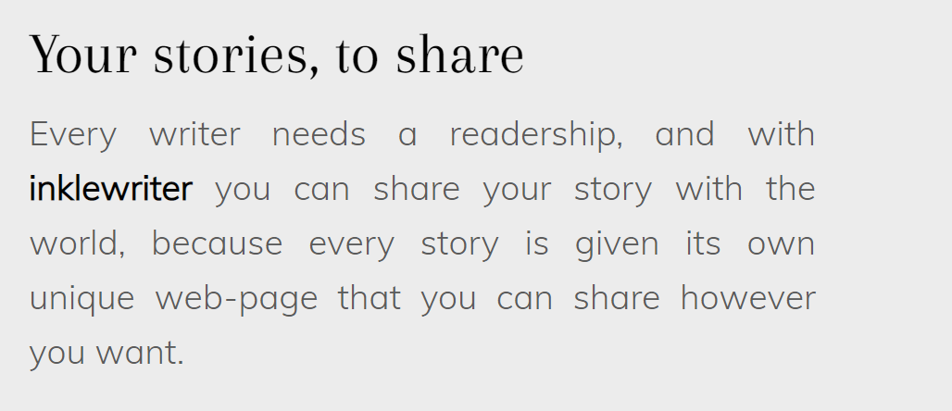
Where my creations would be stored?
Once the user sign up to the platform and create an account, all his creations will be stored on cloud in his account.

Slide 8
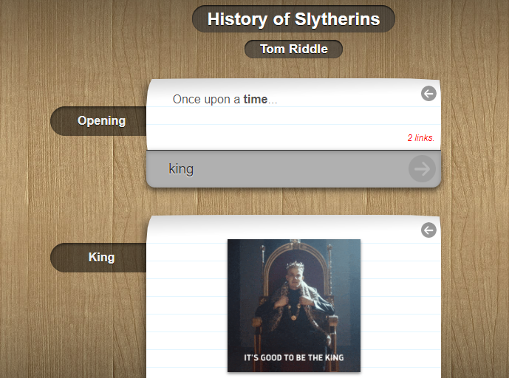
ABOUT THE INTERFACE
Title
Writer
Paragraphs
Options
Option Root
Merging the roots
Notes:
https://www.youtube.com/watch?v=GnXcWwV1p_g

Slide 9
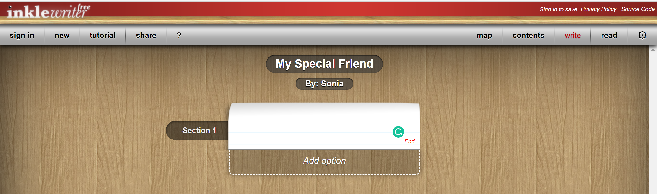
Section Name
Map
Marker
Marker Conditions
Notes:
https://www.youtube.com/watch?v=GnXcWwV1p_g

Slide 10
Let’s have a walk-through of the platform

Slide 11
How to use it-Recap Video?
https://www.youtube.com/watch?v=GnXcWwV1p_g
Notes:
https://www.youtube.com/watch?v=GnXcWwV1p_g

Slide 12
Subject Integration Ideas

Slide 13
METALS AND NON-METALS

Slide 14
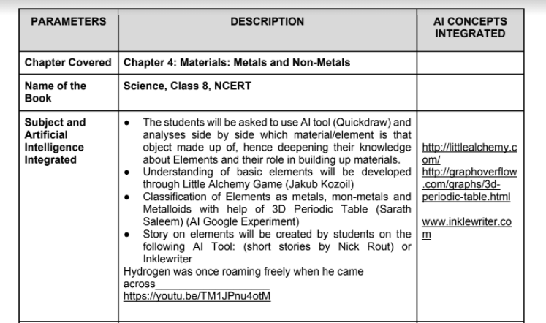

Slide 15
The Monkey and the Crocodile
G6,C6

Slide 16
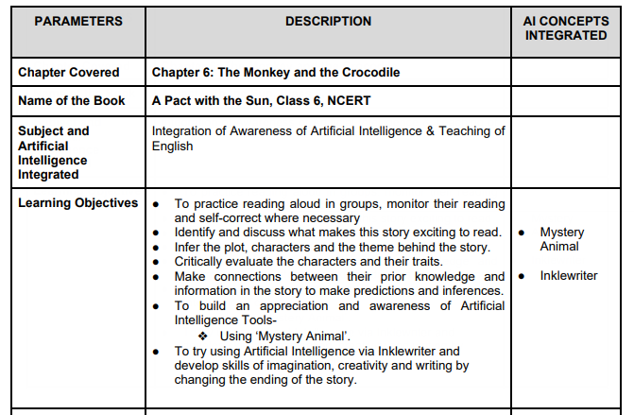

Slide 17
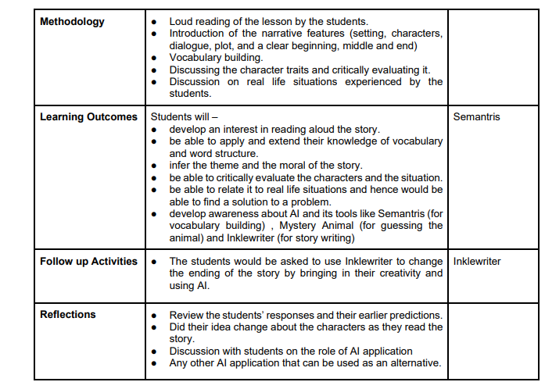

Slide 18
….. The facilitators can also use the tool for making interactive lessons and quizzes for sharing…..

Slide 19

This Photo by Unknown Author is licensed under CC BY-NC-ND

